Slide 1
Operations Modelling Challenge
Sri RamaJayam
Organized by OpperHeimer – Optima – IITKGP – ORMAE
Presented By:
Hariharan Subramanian – SASTRA University
SSVKSS JyothirAditya -IIT Kharagpur
Please visit GitHub link for revised presentation and code
GitHub Link : https://github.com/shariharan2002/Heterogenous-Fleet-and-Commodity-VRP/

Slide 2
Preliminary Answers to Questions
Q1
In our trial runs, we found that Vessel V4 was heavily used
Q2
Depots are visited once per commodity type
Q3
Answered via the formulation/optimization model. We load only one product per vessel.

Slide 3
Intro to the problem statement
We are given a set of refineries(oil production centres), oil depots(oil demand centres) with variable demands.
We are given different types of products, which are being produced in variable quantities
We are also given various types of vessels, each with different capacities and costs of travel.

Slide 4
Our Approach
We saw existing papers in the literature and found one paper that closely resembled the problem statement given.
The paper had implemented A branch and Price algorithm for Heterogenous Fleet MultiDepot-MultiTrip Vehicle Routing Problem With Time Windows
We removed the time windows capability and extended the formulation to add Heterogenous commodities
However, we were unable to extend the formulation to account for >1 product within a single vessel
We also did not delve into advanced Integer programing techniques(like branch and price, or column generation).
Instead for classic MIP problems, we chose to stick with the CPLEX branch and bound solver due to shortage of time.

Slide 5
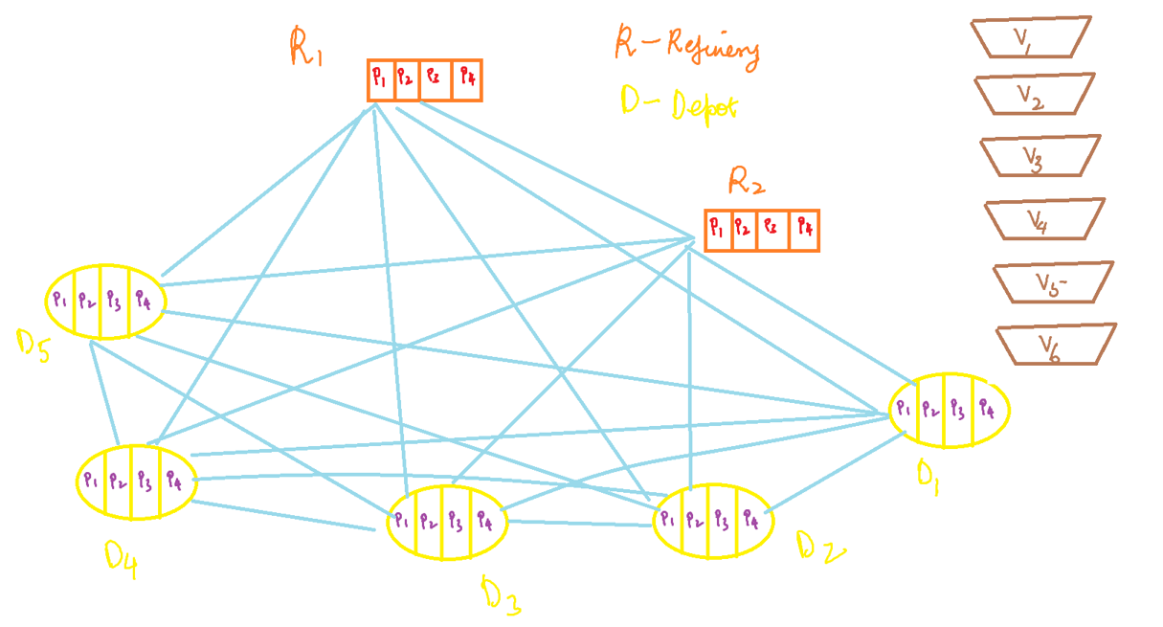

Slide 6
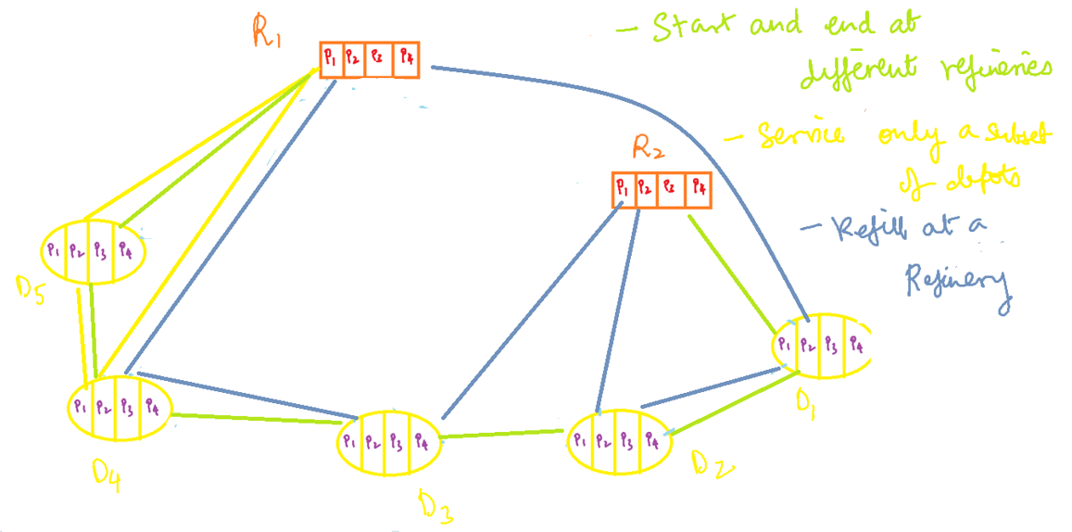

Slide 7
Aim and Assumptions
Aim: To find sets of trips that both start and end at refineries with minimum cost.
Assumptions:
Set of trips should satisfy that each depot is visited only once for each commodity type.
Total demand of depots in a trip should not exceed the vessel capacity.
Capacity consumption of a vessels assigned to refinery should not exceed the refinery capacity.
Trips can start and end at any refinery
Each vessel is allowed to perform several trips, and can start and end each of its trips at any refinery.
The no. of vessels for each vessel type at each refinery is assumed to be unlimited. No. of vessels can be limited using a procurement cost per vessel.
No. of vessels at each depot at start and end of workday should remain the same

Slide 8
Overall Flow
Find all paths and store it in global paths set
Define the IP formulation
Feed the paths, and solve using CPLEX
Find feasible paths between all depot start and end combinations w.r.t vessel capacity, refinery capacity and demand satisfaction

Slide 9
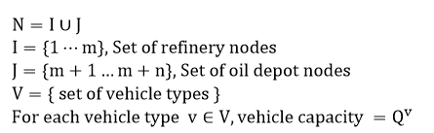
Notation and Terminology

Slide 10

Notation and Terminology
$q_{j,c}$ : Each depot node $j∈J$, has a demand for commodity $c∈C$ as
$V_{j,c}$ : For each depot node $j∈J$, the set of vessels that can serve depot $j$ for commodity $C∈C$ is given by:
$$V_{j,c}=\left\{v∈V∣q_{j,c}≤Q^{v}\right\}$$

Slide 11
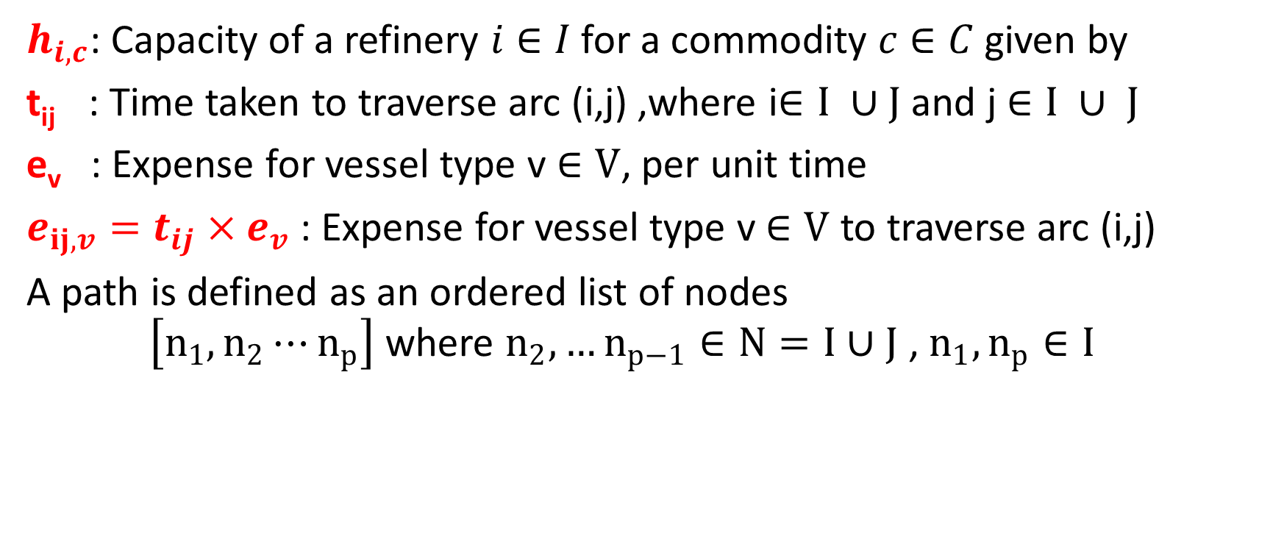
Notation and Terminology
$h_{i,c}$: Capacity of a refinery $i∈I$ for a commodity $c∈C$ given by
t_{ij} : Time taken to traverse arc (i,j) ,where i$∈I ∪J$ and j $∈I ∪ J$
e_{v} : Expense for vessel type v $∈V$, per unit time
$e_{ij,v}=t_{ij}×e_{v}$ : Expense for vessel type v $∈V$ to traverse arc (i,j)
A path is defined as an ordered list of nodes $\left[n_{1},n_{2}⋯n_{p}\right]$ where $n_{2},…n_{p−1}∈N=I∪J$ , $n_{1},n_{p}∈I$

Slide 12

Notation and Terminology
Let all paths belong to a global path set P
The set of feasible paths for vessel type v $∈V, commodity type c ∈C$ is given by $P_{v,c}$

Slide 13
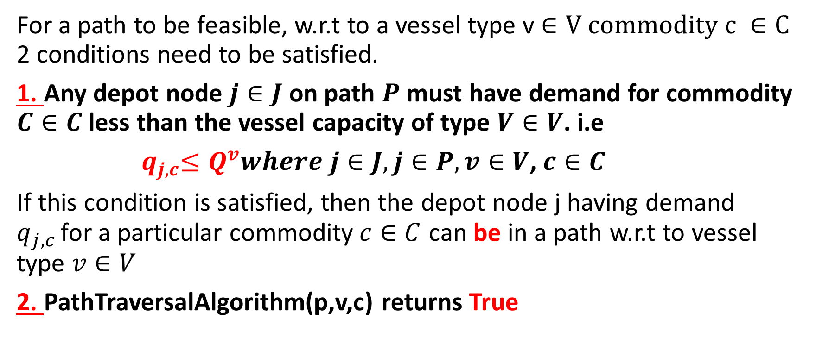
Defining the feasibility of a path
For a path to be feasible, w.r.t to a vessel type v $∈V$ $commodity c ∈C$ 2 conditions need to be satisfied.
1. Any depot node $j∈J$ on path $P$ must have demand for commodity $C∈C$ less than the vessel capacity of type $V∈V$. i.e
${ q}_{j,c}≤Q^{v}where j∈J,j∈P, v∈V$, $c∈C$
If this condition is satisfied, then the depot node j having demand $q_{j,c }$for a particular commodity$c∈C$ can be in a path w.r.t to vessel type $v∈V$
2. PathTraversalAlgorithm(p,v,c) returns True

Slide 14
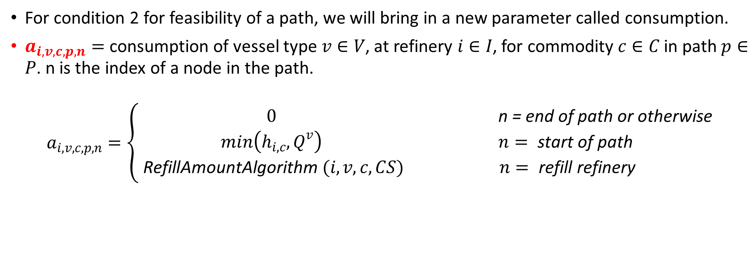
Consumption Parameter
For condition 2 for feasibility of a path, we will bring in a new parameter called consumption.
$a_{i,v,c,p,n}=$ consumption of vessel type $v∈V$, at refinery $i∈I$, for commodity $c∈C$ in path $p∈P$. n is the index of a node in the path.
$$a_{i,v,c,p,n}=\left\{\begin{matrix}0 & \text{n} \text{=} \text{end} \text{of} \text{path} \text{or} \text{otherwise} \\ min\left(h_{i,c},Q^{v}\right) & n= \text{start} \text{of} \text{path} \\ \text{RefillAmountAlgorithm} (i,v,c,CS) & n= \text{refill} \text{refinery}\end{matrix}\right.$$

Slide 15
How does the consumption parameter work?
Start of a path: We refill to the entire capacity of vessel. There might be a possibility when the vessel s’ capacity might exceed the refinery s’ capacity. In these cases, we fill the vessel with the entire refinery s’ capacity, thus emptying the refinery. In other cases, we consume only that amount from the refinery, that will make our vessel full.
End of a path: This means our trip has ended and we shall not refill.
Middle of a path: We have encountered a refinery node, then there is a scope for refill. The amount to be refilled is given by RefillAmountAlgorithm.

Slide 16
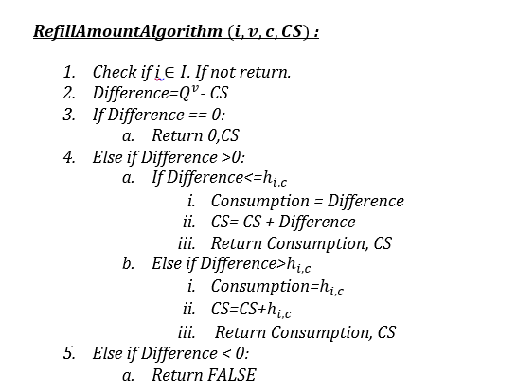
RefillAmountAlgorithm

Slide 17
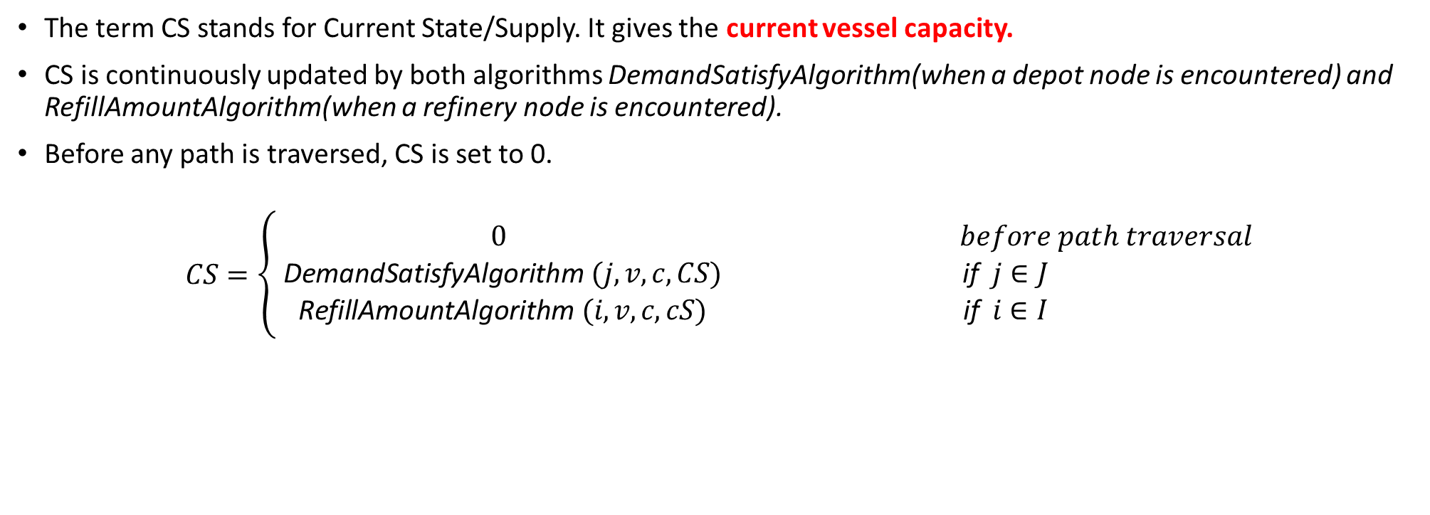
Current State/Supply
The term CS stands for Current State/Supply. It gives the current vessel capacity.
CS is continuously updated by both algorithms DemandSatisfyAlgorithm(when a depot node is encountered) and RefillAmountAlgorithm(when a refinery node is encountered).
Before any path is traversed, CS is set to 0.
$$CS=\left\{\begin{matrix}0 & before path traversal \\ \text{DemandSatisfyAlgorithm} (j,v,c,CS) & \text{if} j∈J \\ \text{RefillAmountAlgorithm} (i,v,c,cS) & \text{if} i∈I\end{matrix}\right.$$

Slide 18
The 3 Algorithms
The RefillAmountAlgorithm is encountered when a node is refinery node
The DemandSatisfyAlgorithm is encountered when a node is depot node
The PathTraversalAlgorithm traverses each node of the path and calls the appropriate algorithm based on type of node(refinery or depot)
CS is in fact updated by both DemandSatisfyAlgorithm and RefillAmountAlgorithm

Slide 19
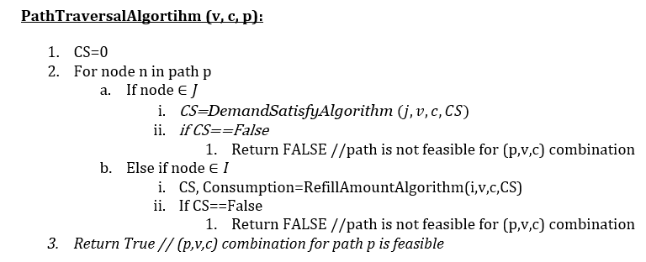
PathTraversalAlgorithm

Slide 20
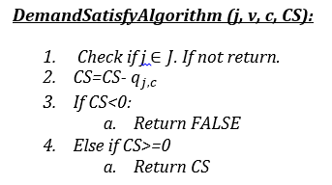
DemandSatisfyAlgorithm

Slide 21
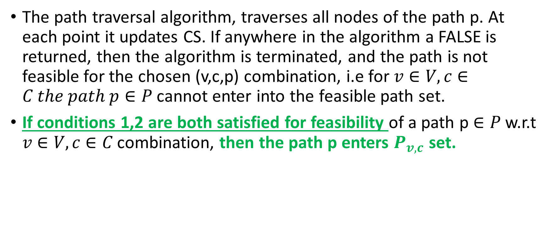
Back to path feasibility
The path traversal algorithm, traverses all nodes of the path p. At each point it updates CS. If anywhere in the algorithm a FALSE is returned, then the algorithm is terminated, and the path is not feasible for the chosen (v,c,p) combination, i.e for $v∈V, c∈C the path p∈P$ cannot enter into the feasible path set.
If conditions 1,2 are both satisfied for feasibility of a path p $∈P$ w.r.t $v∈V, c∈C$ combination, then the path p enters $P_{v,c}$ set.

Slide 22
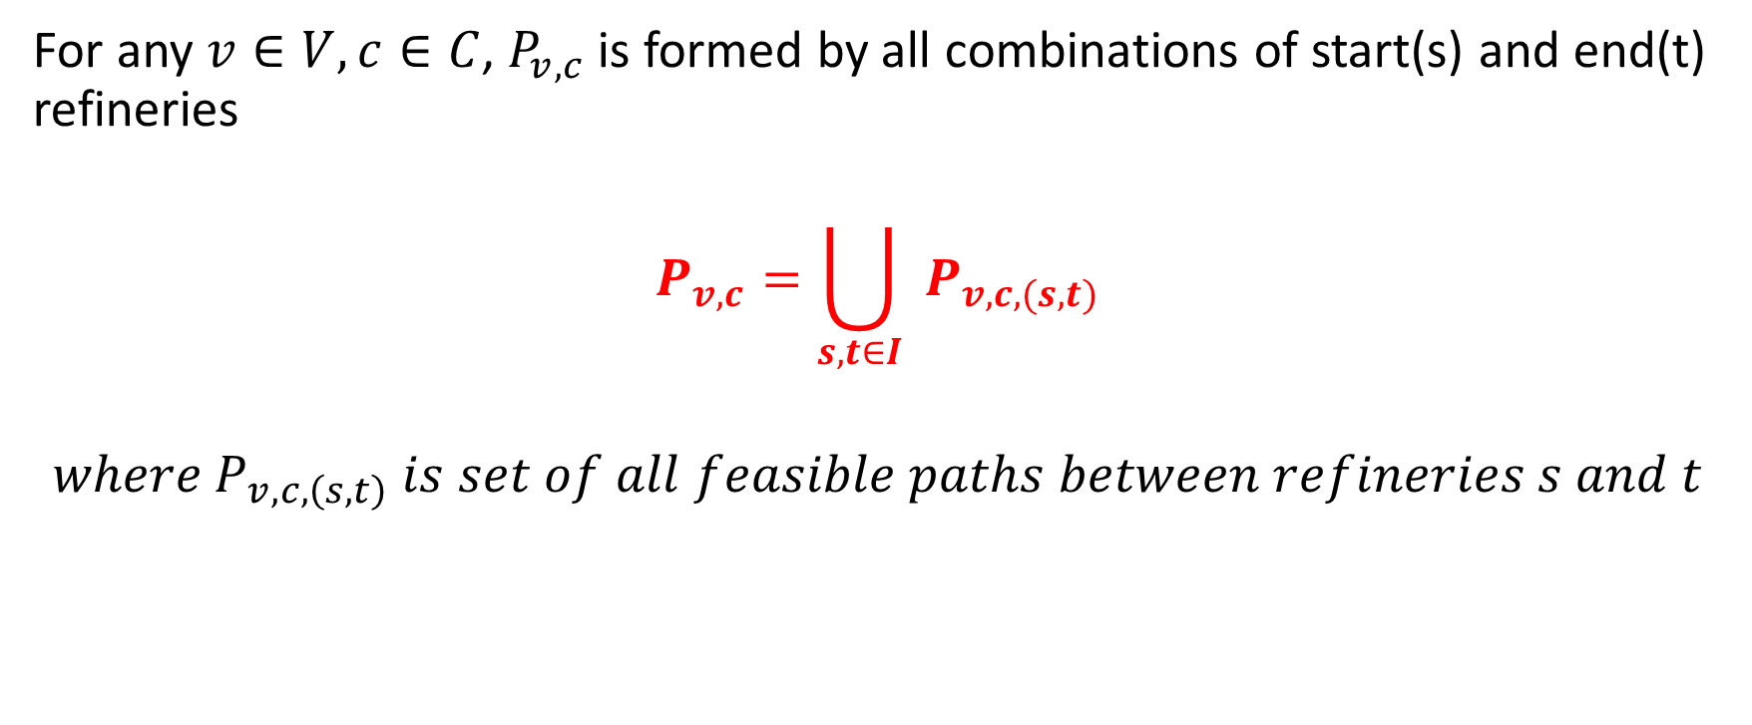
Path feasibility between any 2 refineries
For any $v∈V, c∈C$, $P_{v,c}$is formed by all combinations of start(s) and end(t) refineries
$$P_{v,c}=\bigcup_{s,t∈I}{ }P_{v,c,(s,t)}$$
$${where P}_{v,c,\left(s,t\right)} is set of all feasible paths between refineries s and t$$

Slide 23

Expense of a path
Expense of a path $Δ_{v,c,p}$ is defined as:
$$Δ_{v,c,p}=\sum{ }e_{ij,v}$$
Where ij is arc present in path p$∈P_{v,c}$ $,v∈V, c∈C$

Slide 24
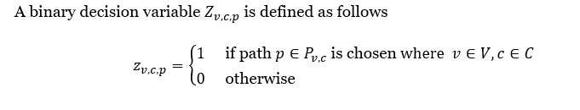
Decision Variable

Slide 25
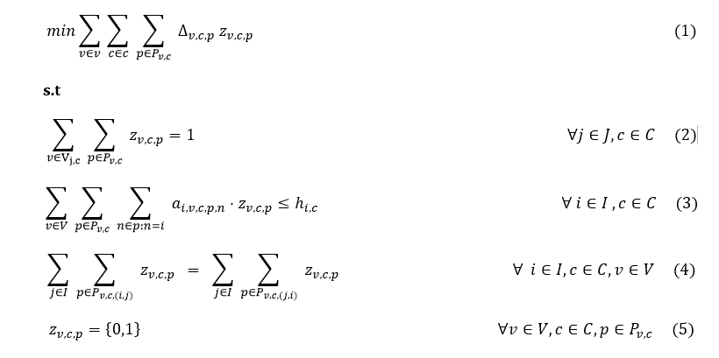
Integer Program Formulation

Slide 26

Objective Function
Defines the objective function and minimizes the overall routing cost

Slide 27

Depot should be visited once
Imposes that for each depot, for each commodity type, the depot node should be visited only once

Slide 28

Capacity of Refinery not exceeded
Ensures that total capacity consumption of vessels assigned to a refinery does not exceed the refinery capacity

Slide 29

Balance of Vehicle types at each Refinery
Ensures that the total no. of vessels per vessel type remain the same at each refinery at the start and end of workday

Slide 30
Can we make consumption parameter more efficient?
Yes we can, for this we build another algorithm – RemainingDemand Algorithm
Using this algorithm, the vessel only consumes that amount of material that is needed for the depot nodes remaining on its path

Slide 31
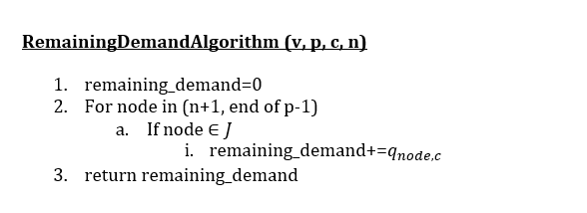

Slide 32

Consumption parameter changes as follows

Slide 33
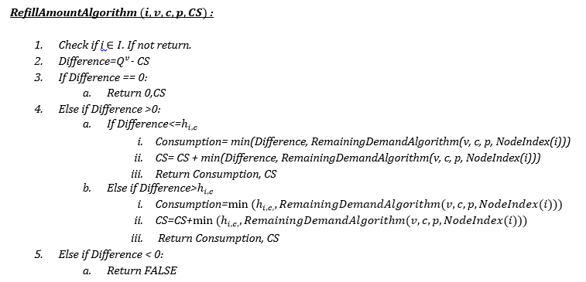

Slide 34
What might be the disadvantages?
We tune the consumption of a vessel at a refinery for a commodity manually using logical ideas. This may not entirely be optimal. The most optimal way would be to make the consumption parameter itself a decision variable and let the solver decide. However, with the given constraints, it might be possible that the formulation becomes non-linear(product of decision variables). Hence we chose to avoid this.
When we choose to change the consumption parameter from one feasible path to another feasible path based on various factors(in our case, CS, remaining demand and so on), the formulation cannot be easily extended to solve large scale problems. I.e when the consumption parameter is a constant, the pricing subproblem is SPPRC(Shortest path problem with Resource Constraints). But when it’s not a constant, all feasible paths need to be enumerated, and fast IP solving techniques like Column Generation and/or Branch and Price cannot be employed.
This is one of the main reasons that the author of the research paper chose to keep the consumption parameter constant so as to allow tractability.

Slide 35


Using old consumption parameter
Using new consumption parameter

Slide 36
Extending the formulation to multiple days
We introduce slightly new notation for extending the formulation to cover the demand for multiple days

Slide 37
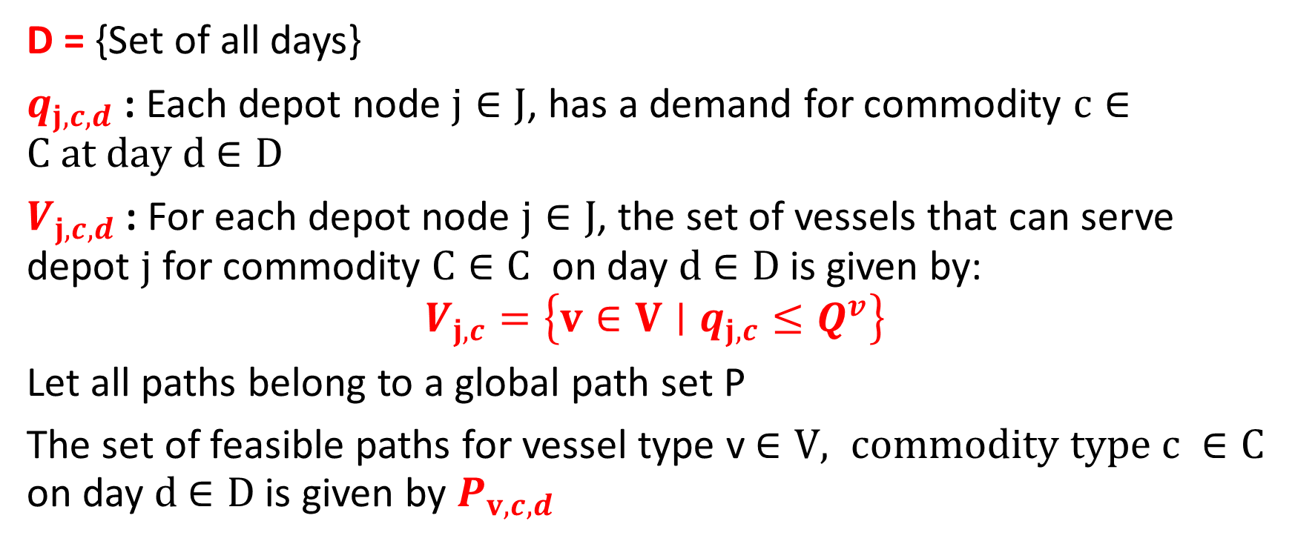
Notation and Terminology
D = {Set of all days}
$q_{j,c,d}$ : Each depot node $j∈J$, has a demand for commodity $c∈C at day d$ $∈D$
$V_{j,c,d}$ : For each depot node $j∈J$, the set of vessels that can serve depot $j$ for commodity $C∈C$ on day $d$ $∈D$is given by:
$$V_{j,c}=\left\{v∈V∣q_{j,c}≤Q^{v}\right\}$$
Let all paths belong to a global path set P
The set of feasible paths for vessel type v $∈V, commodity type c ∈C$ on day $d$ $∈D$is given by $P_{v,c,d}$

Slide 38
Change in path restrictions
Previously we allowed vessels to refill at intermediate refineries.
However, for the multi-day problem, we do not allow refilling.
Also, a vessel for a commodity c shall take part in a trip/path only if it can satisfy all the depot demands on that path. Else it shall not take that trip.
These restrictions manifest on path feasibility conditions

Slide 39

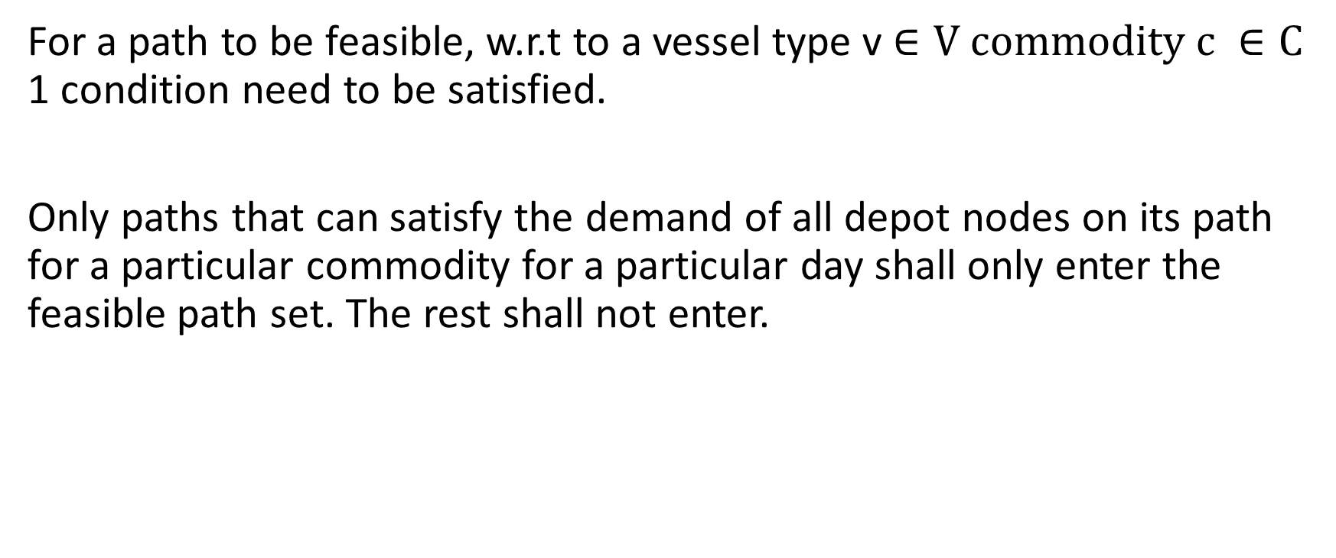
Path Feasibility
For a path to be feasible, w.r.t to a vessel type v $∈V$ $commodity c ∈C$ 1 condition need to be satisfied.
Only paths that can satisfy the demand of all depot nodes on its path for a particular commodity for a particular day shall only enter the feasible path set. The rest shall not enter.

Slide 40
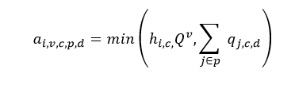
Consumption Parameter
Note that: removing the refilling possibility for any vessel, makes the consumption parameter easy to compute
This means that consumption by a vessel is only done at the start refinery.
While it can pass through a refinery node, it shall not consume/refill any commodity

Slide 41
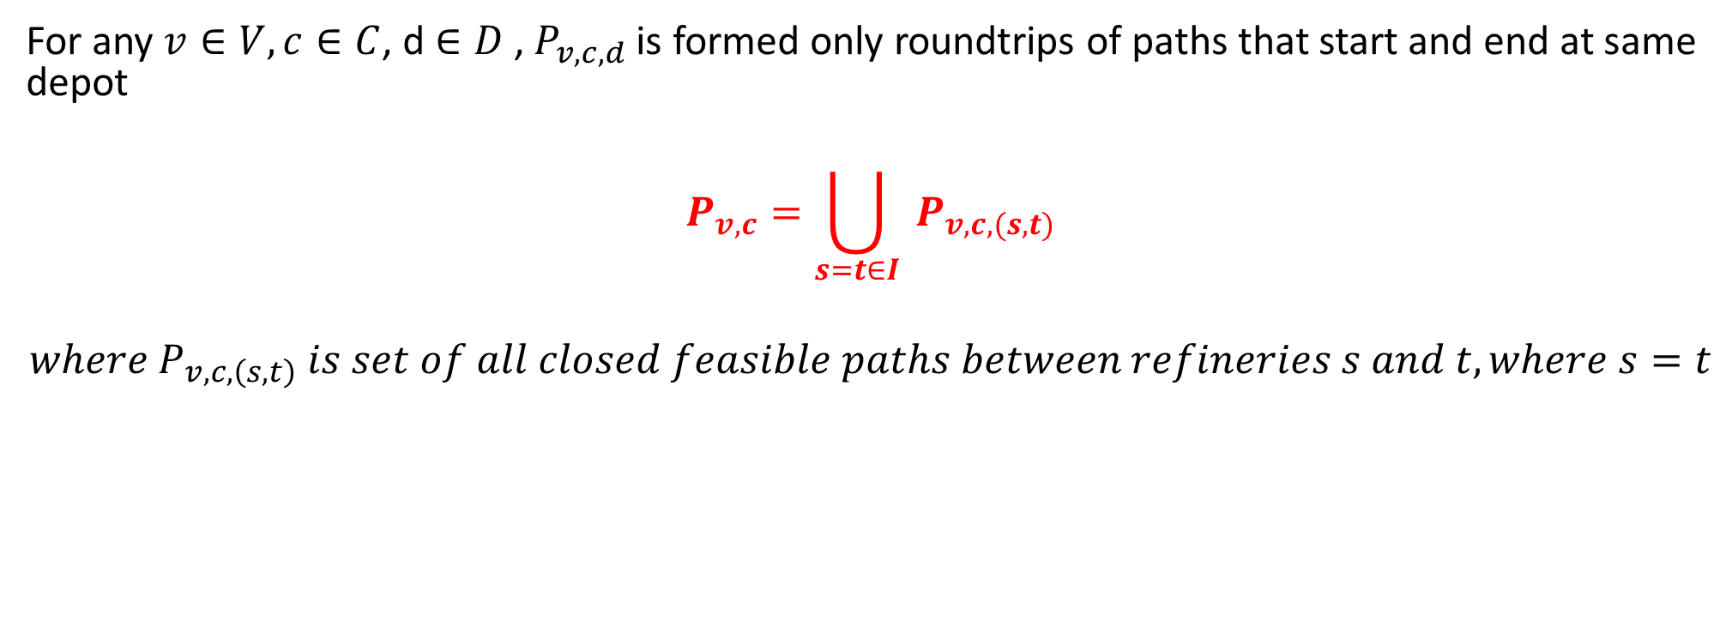
Path Feasibility between 2 same refineries
For any $v∈V, c∈C$, d $∈D$ , $P_{v,c,d}$is formed only roundtrips of paths that start and end at same depot
$$P_{v,c}=\bigcup_{s=t∈I}{ }P_{v,c,(s,t)}$$
$${where P}_{v,c,\left(s,t\right)} is set of all closed feasible paths between refineries s and t, where s=t$$

Slide 42

Expense of a path
Expense of a path $Δ_{v,c,p,d}$ is defined as:
$$Δ_{v,c,p}=\sum{ }e_{ij,v}$$
Where ij is arc present in path p$∈P_{v,c,d}$ $,v∈V, c∈C,\text{d} ∈D$

Slide 43
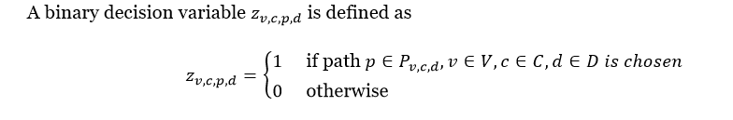
Decision Variable

Slide 44
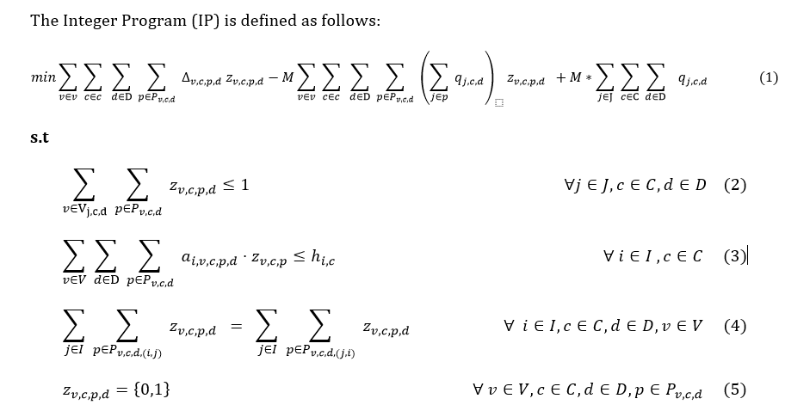
Integer Program Formulation

Slide 45

This term represents the routing cost
This term represents the demand satisfied by chosen paths
This term represents the total demand that needs to be fulfilled and is a constant.
The difference between total and satisfied demand represents unsatisfied demand
M is a big constant that is used in order to balance the routing and demand components. If the routing cost is too high than the unsatisfied demand, then the solver shall choose not to select any path and hence the overall cost might be the last term.

Slide 46

Depot can be visited at most once
The above imposes that a depot for a particular commodity c, on a particular day d can atmost be visited once. It need not be visited at all, but if visited, it can only be visited once

Slide 47
Refinery Capacity Constraint
The overall consumption by all vessels across all days must be less than the refinery capacity for that particular commodity

Slide 48

Refinery Vessel Type Balance Constraints
The no. of vessels of a particular vessel type leaving at the start of a workday and returning back at the end of a workday must be the same for each day

Slide 49
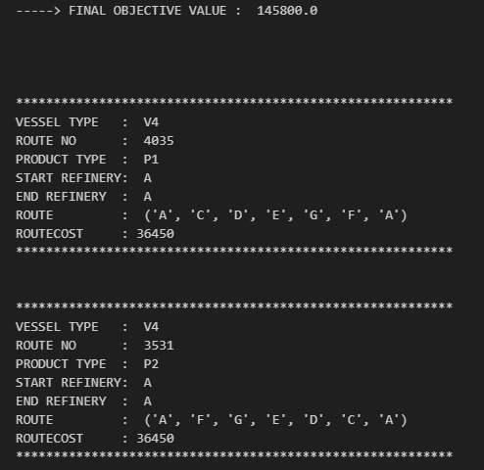
Single Day Sample Output

Slide 50
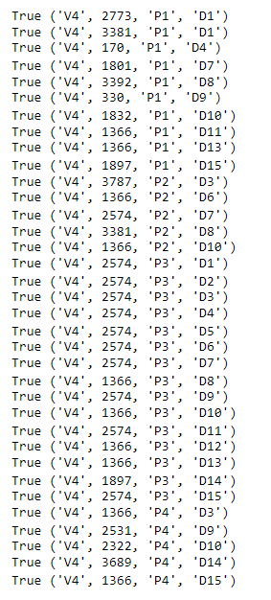

Multi Day Sample Output
Notice that for some days, the demand for a particular commodity could not be fulfilled.
Eg: For product P1, days D2, D3 could not be filled

Slide 51
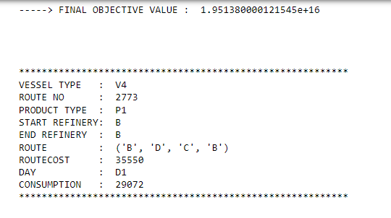

The high objective value is due to the penalty in not satisfying demands
M was set to 10^10
The difference in total demand to be satisfied and the demand satisfied by the model

